Slide 1
Sales Assessment
Presented by:
Group 6
Ashok Sri Harsha Nettem 0781998
Prathapreddy Pannala 0788713
Dhruviben Hitendrabhai Patel 0788987
Fenil Ashwinbhai Patel 0779094
Kenil Chandrakant Patel 0786809
Analysis project
DAB-303- Marketing Analytics
Last Updated: April 18th, 2022

Slide 2
Road Map
Over view of problem
Data Description
EDA: outliers
Data analysis
Result
Interpretation
Future recommendation

Slide 3
Overview Of Problem
Analyzing how the dealers' revenue is distributed.
How much revenue is generated based on customer size?
Is the revenue increased in 2021 compare to 2020?
Any reason behind the maximum revenue ?
Assessing the top ten and lowest ten stores' performance.
Discovering the revenue-generating components.

Slide 4
Data Description
For 2020 and 2021, this is the Stores data from a sales assessment dataset with over 2500 vehicle store records. The columns that provide information about the stores are as follows:
Store Master:
28 features and 2586 observations
20 Numerical features and 8 Categorical features
Products Sold by type(Qty):
17 features and 2589 observations
16 Numerical features and 1 Categorical features
Products Sold by type(Price):
17 features and 2589 observations
16 Numerical features and 1 Categorical features
Data cleaning
We replaced the missing values with 0 in numerical variables and with ‘Unknown’ in categorical variables.

Slide 5
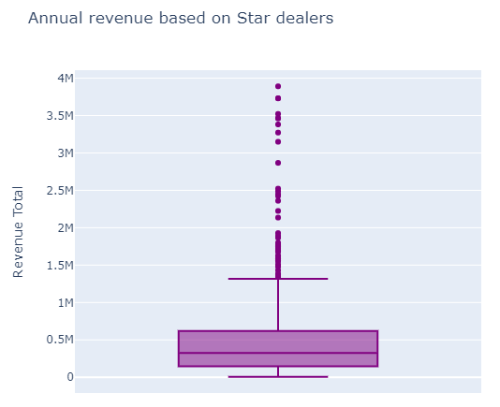
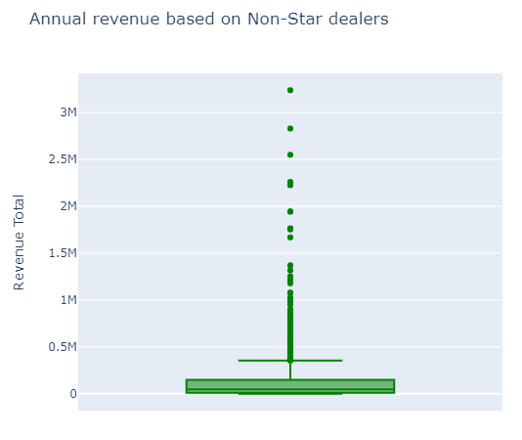
EDA: Analyzing how the dealers' revenue is distributed
Compare to Non-star dealers, star dealers have made the highest revenue
And there are only few Revenue_totals values after 3.5M for both the graphs that we can consider it as outliers.

Slide 6
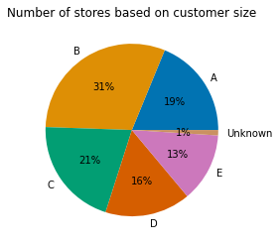
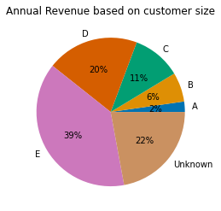
How Much Revenue Is Generated Based On Customer Size?
Found that nearly 30% stores have the customer size (B) but customer size (E) have made a maximum revenue

Slide 7
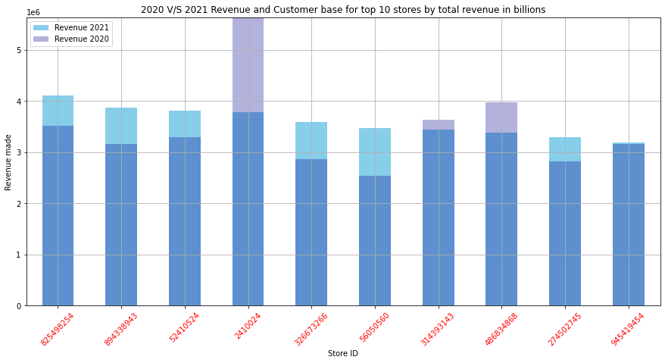
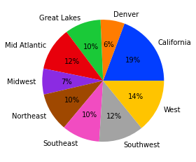
Is The Revenue Increased In 2021 Compare To 2020?
California has made a maximum revenue compare to other regions
Mostly revenue increased in 2021 compare to 2020 except 3 stores which we can see in the below plot.

Slide 8
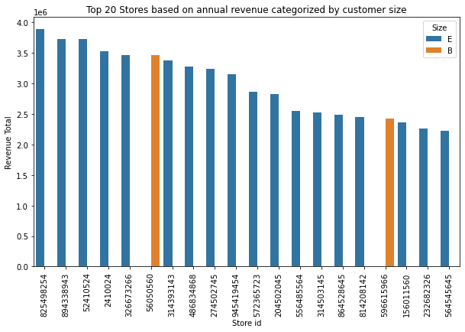
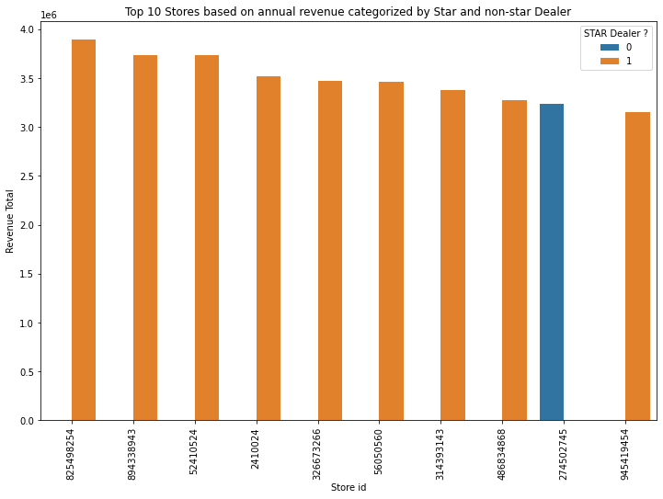
One of the reason behind the maximum revenue ?
Top 20 stores have large customer size (E) except 56050560 and 596615966 store id have the small customer size (B).
Found that small customer size who have made maximum revenue have attended the STAR program

Slide 9
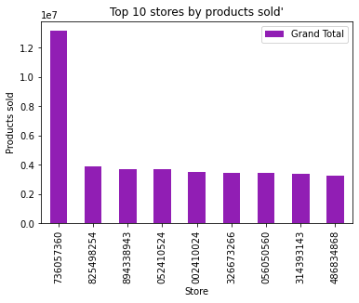
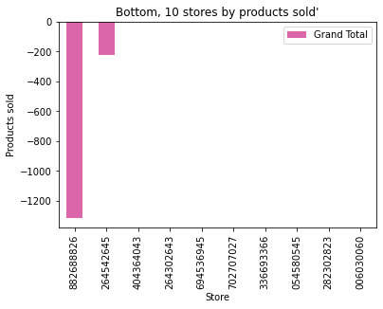
Assessing the top ten and lowest ten stores' performance.
Stores needs to be more focus on so can make a better revenue
Stores that have made a maximum revenue

Slide 10
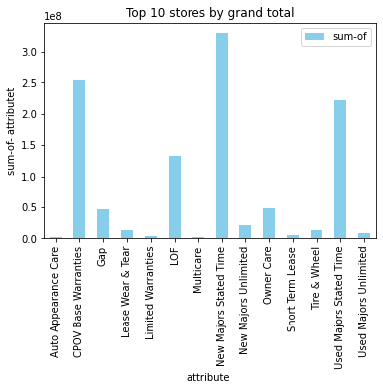
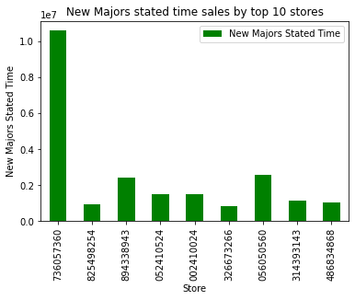
Discovering the revenue-generating components
Store ID 736057360 has made a maximum revenue with New Majors Stated Time attribute
New Major Stated Time has made the maximum revenue

Slide 11
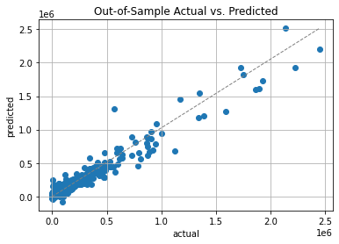
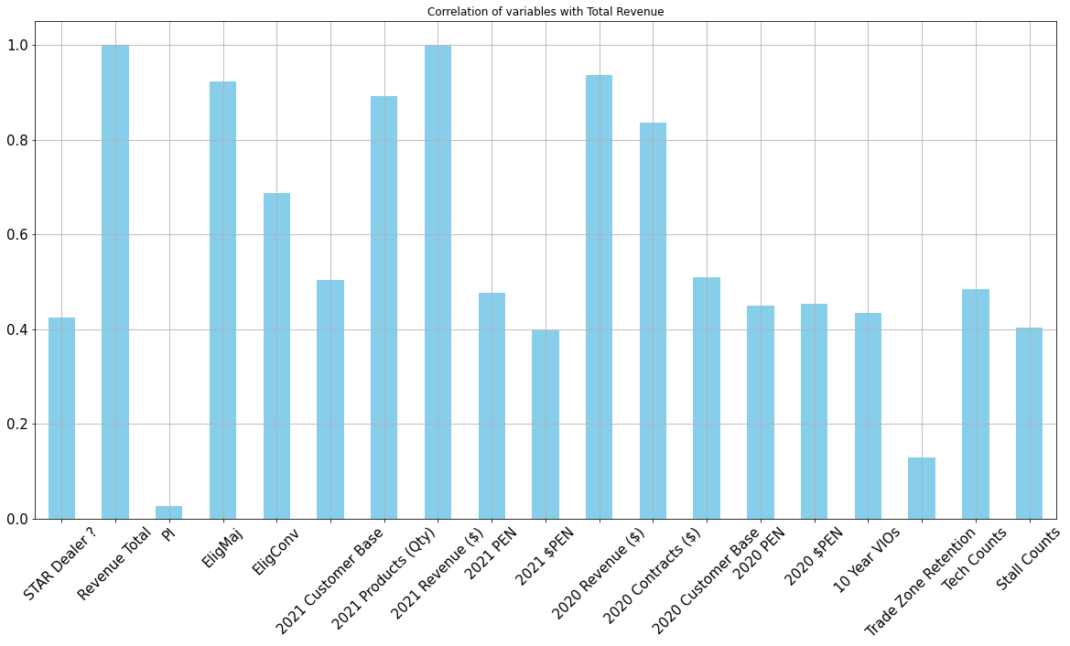
Results
Created a model by removing the strongly correlated variables like, 2021 and 2020 Revenue
Linear regression model
Getting 94% of accuracy(r-squared) which is quite good

Slide 12
Interpretation
Dealers should try to attend the star program which helps to improve the annual revenue
Some stores that have small customer size like B size, made a good revenue because dealers had attended the STAR Program
Customers are more likely to buy new and used major stated time, CPOV based warranties
We need to focus on stores which have made revenue in a negative

Slide 13
Future recommendation
Try to keep track of highest and lowest purchase products
Take feedback from the customer and try to fulfill their requirements
Provide offers to the customers based on current market
Try to figure out relationship between customers and product categories

